Slide 1

WAVE
LET YOUR MONEY FLOW
Your money.
One clear picture.
Send. Save. Spend. Understand.
A connected money-management experience designed for everyday Nigerians.
PITCH DECK • 2026
The money app for Africa

Slide 2
WAVE
LOGO STORY · THE IDEA
15
Inspired by the natural flow of water.
A symbol for money in motion.
THE CONCEPT
Wave’s logo takes inspiration from the fluid movement of water. That fluidity reflects how funds move through the app.
The design direction was intentional: keep the mark simple, clear and easy to recognize.
FLUIDITY
MOVEMENT
SIMPLICITY
WAVE • LET YOUR MONEY FLOW

Slide 3
WAVE
LOGO STORY · BUILDING THE IDENTITY
16
From a simple mark to a recognizable identity.
COLOUR PALETTE
TYPOGRAPHY
Inter
Blue
Turquoise
Cyan
The design process used Inter and Poppins.
#0197FC
#32E4F7
#3DDBFD
Aa Bb Cc Dd Ee Ff Gg Hh Ii Jj Kk Ll Mm
Nn Oo Pp Qq Rr Ss Tt Uu Vv Ww Xx Yy Zz
Black
White
Pale Blue
#000000
#FFFFFF
#EAF5FD
The overall direction: simple, legible and easy to recognize.
WAVE • LET YOUR MONEY FLOW

Slide 4
WAVE
THE OPPORTUNITY
02
Money moves. The experience is still fragmented.
The gap is not simply access to financial services — it is how disconnected they can feel.
01 Fragmented workflows
02 Unclear costs
03 Too much complexity
Sending, saving and tracking spending can happen across different tools and experiences.
When fees are difficult to understand before a transaction, confidence and trust suffer.
Crypto-first interfaces can overwhelm people who simply want to manage everyday money.
THE RESULT
People need more than another place to pay. They need a clearer view of their money.
THE MONEY APP FOR AFRICA • LET YOUR MONEY FLOW

Slide 5
WAVE
THE INSIGHT
03
The opportunity is connection.
Wave’s competitive analysis found that transfers and savings alone are not enough to stand out.
TODAY
THE WAVE IDEA
Send • Save • Spend
Send → Save → Spend
→ Understand
Useful features, often experienced as separate tasks.
One connected picture of money in motion.
OUR POSITIONING
Wave gives you one clear picture of your money.
THE MONEY APP FOR AFRICA • LET YOUR MONEY FLOW

Slide 6
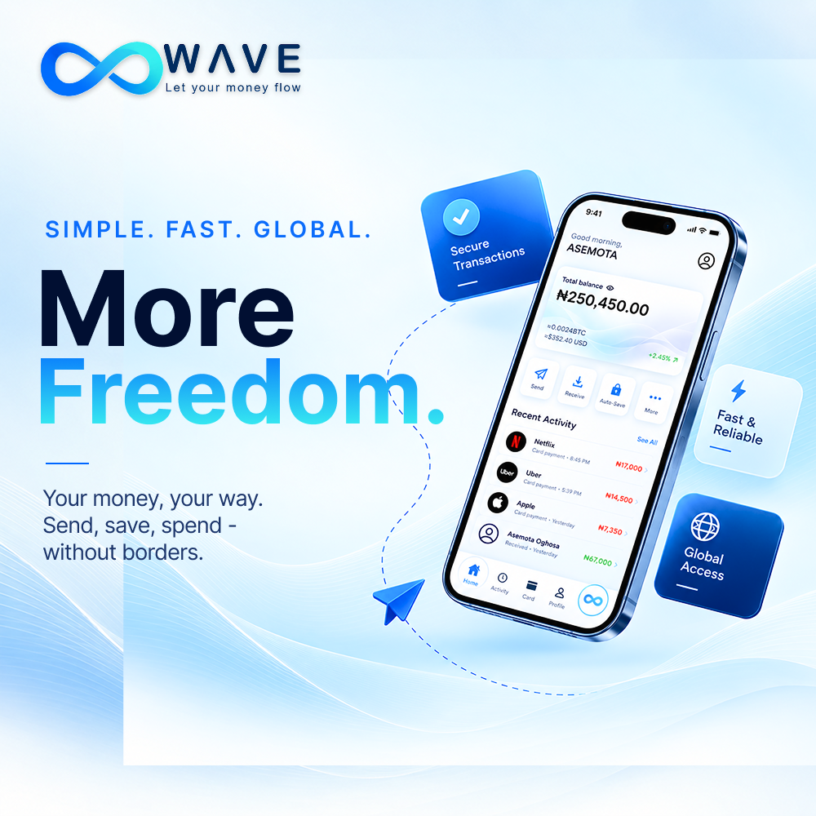
WAVE
THE SOLUTION
04
One home for everyday money.
A Naira-first experience that keeps the user in control and hides technical complexity.
SEND
SAVE
SPEND
UNDERSTAND
Move money with familiar identifiers such as a phone number or @username.
Build a saving habit through simple tools and automatic round-ups.
Connect digital balances to everyday card spending and bill payments.
See activity and money movement more clearly in one place.
THE PROMISE
Modern financial technology — without the learning curve.
THE MONEY APP FOR AFRICA • LET YOUR MONEY FLOW

Slide 7
WAVE
PRODUCT EXPERIENCE
05
Designed around what people actually do.
Keep the main actions simple; show costs and activity clearly.
01
02
03
04
Open Wave
Choose an action
See the details
Understand the flow
A clean, approachable Naira-first home screen.
Send, save or spend from one connected experience.
Review fees, total deducted and recipient amount before confirming.
Use visible activity and insights to follow where money goes.
WAVE RULE
If a 15-year-old can’t explain it in 10 seconds, simplify it.
THE MONEY APP FOR AFRICA • LET YOUR MONEY FLOW

Slide 8
WAVE
TARGET MARKET
06
Start with digitally active Nigerians.
Wave’s initial go-to-market is consumer-first: prove repeat everyday use before expanding.
Students & young adults
Young professionals
Freelancers & creators
Frequent transfers, tight budgets and a need for clarity.
Manage income, bills, spending and savings in one flow.
Receive digital income and organise funds more clearly.
First-time FinTech users
Mobile-first consumers
Future SMEs
A familiar experience without crypto jargon.
Expect fast, simple smartphone experiences.
Potential expansion into merchant collections and payments.
THE MONEY APP FOR AFRICA • LET YOUR MONEY FLOW

Slide 9
WAVE
WHY NOW
07
Digital payments are already familiar.
Wave’s opportunity is to improve the connected experience around them.
The behaviour is already changing.
3.49B
CBN figures cited in the Wave pitch script report more than 5.6 billion NIP transactions worth ₦476.89 trillion in H1 2024.
mobile-payment transactions
reported in H1 2024
Source figures from the supplied Wave pitch script; verify against original CBN publications before external use.
THE MONEY APP FOR AFRICA • LET YOUR MONEY FLOW

Slide 10
WAVE
FINANCIAL OUTLOOK
11
A clear path to testing the economics.
Base-case Scenarios backed by yearly estimates from the supplied Wave Financial Research; transfer fees only.
Metric | Year 1 | Year 2
Active users | 20,000 | 60,000
Annual transactions | 960,000 | 3,600,000
Transaction value | ₦24.0B | ₦99.0B
Transfer-fee revenue | ₦24.0M | ₦97.2M
Direct transaction costs | ₦7.68M | ₦30.6M
Gross contribution | ₦16.32M | ₦66.6M
Operating expenses | ₦112.9M | ₦162.0M
Operating result | −₦96.58M | −₦95.4M
KEY TAKEAWAY
Growth alone won’t solve the economics.
The model shows operating losses in both years. Wave must validate pricing, partner costs, retention and additional revenue streams.
All figures are planning assumptions, not audited results or guaranteed forecasts.
THE MONEY APP FOR AFRICA • LET YOUR MONEY FLOW

Slide 11
WAVE
COMPETITIVE LANDSCAPE
08
Why we’re different
Wave’s own competitive review identifies strong incumbents with overlapping financial features.
PalmPay
Everyday-finance ecosystem
HIGH
Moniepoint
Banking and transaction infrastructure
VERY HIGH
Kuda
Digital banking experience
HIGH
PiggyVest
Savings and wealth building
MEDIUM
Cowrywise
Automated savings and investing
MEDIUM
Wave’s opportunity: connect the actions and give users one clear picture of their money.
THE MONEY APP FOR AFRICA • LET YOUR MONEY FLOW

Slide 12
WAVE
TRACTION & VALIDATION
10
Build Traction before scaling.
Current position: product design and informational website established; MVP under development.
500+
200+
2,000+
10%
beta users
monthly active users
transactions
active users on WAVE+
WHAT WE WILL TEST
• Activation: can a first-time user complete a transfer?
• Retention: do users return to send, save or spend again?
• Trust: do users understand and accept the fees?
• Monetisation: will frequent users pay for WAVE+?
Targets, not current achievements. No production user or revenue traction is reported in the source.
THE MONEY APP FOR AFRICA • LET YOUR MONEY FLOW

Slide 13
WAVE
BUSINESS MODEL
09
Monetise everyday activity — transparently.
The primary financial projection is built around sender-paid transfer fees that increase by transfer size.
Transfer fees
Card & bill activity
WAVE+
Illustrative bands: ₦10 / ₦25 / ₦50 / ₦75 by transfer size.
Potential card-related fees and bill-payment commissions as the product expands.
Proposed ₦500/month subscription for 10 fee-free transfers.
PRICING PRINCIPLE
Show the fee, total deducted and exact amount received before the user confirms.
All pricing is illustrative project modelling, not confirmed commercial pricing.
THE MONEY APP FOR AFRICA • LET YOUR MONEY FLOW

Slide 14
WAVE
ROADMAP & ASK
12
From concept to a trusted everyday product.
We focused on using resources to prove the core money-moving experience before expanding.
NOW
NEXT
VALIDATE
SCALE
Finish MVP
Private beta
Prove repeat use
Expand carefully
Core send / save / spend flows, fee clarity and reliability.
Recruit users, test activation, collect feedback and improve.
Track retention, transaction frequency and pricing acceptance.
Build partnerships and extend card, bills and savings adoption.
THE ASK
Support product development, user testing, compliance readiness, infrastructure and early customer acquisition.
Specific funding amount and investment terms: to be defined by the team.
THE MONEY APP FOR AFRICA • LET YOUR MONEY FLOW

Slide 15
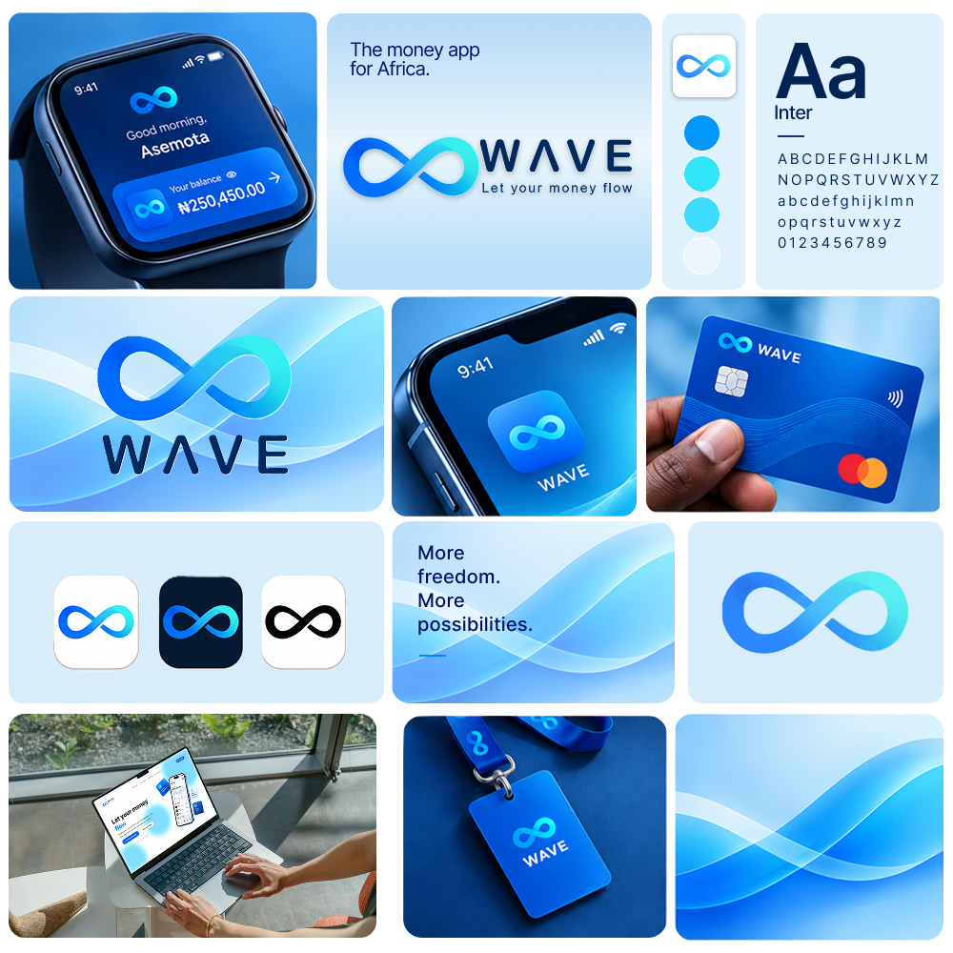
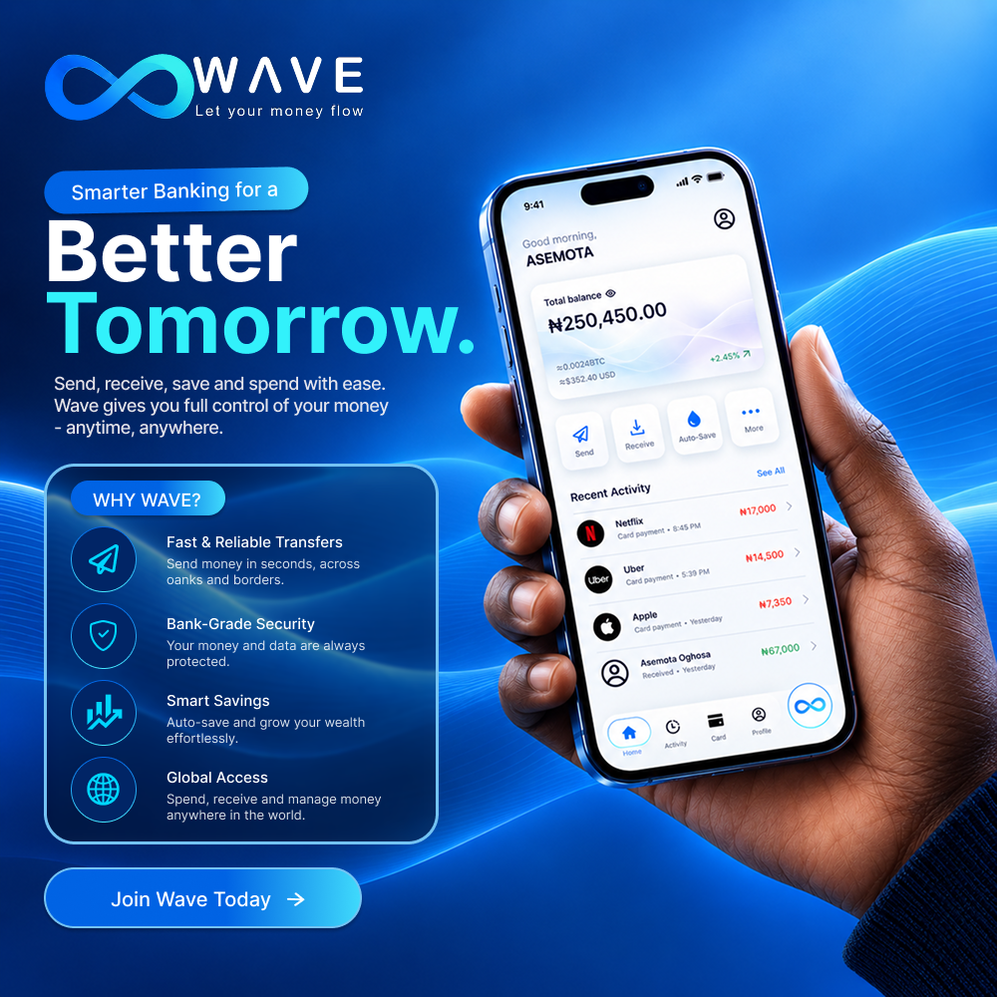
WAVE
VISUAL IDENTITY & PRODUCT DIRECTION
14
A visual language built for clarity.
BRAND & APPLICATION
CAMPAIGN / HERO DIRECTION
VISUAL ASSET SYSTEM
WAVE • LET YOUR MONEY FLOW

Slide 16
WAVE
LET YOUR MONEY FLOW
Money should work
for the user —
not the other way around.
SEND • SAVE • SPEND • UNDERSTAND
Let’s Ride the Wave. Shall We...?
Thank you

